Slide 1
Honey Bee Nutrition
What – when – why & how of feeding honey bees
Gary keuffer
Brown county beekeepers association

Slide 2
To Make a Bee
1 cell of pollen
1 cell of honey
1 cell of water

Slide 3
Honey Bee Healthy Diet
Proteins
Carbohydrates
Minerals
Fats (lipids)
Essential amino acids
Vitamins
Water

Slide 4
Honey Bees Collect
Pollen
Nectar
Water
A Comparison:
Pollen (proteins) = meat
Nectar (carbohydrates) = potatoes
Honey (nectar) = energy
Pollen = babies

Slide 5
Pollen
Pollen supplies
  Proteins
  Fats (lipids)
  Vitamins
  Minerals
  Essential amino acids

Slide 6
Pollen
Pollen stored as bee bread
Pollen nutritional values varies on plant source
Pollen deficiency
  Reduced brood production
  Reduced longevity of workers
  Longer for drones to reach maturity.
  Drones neglected, discarded or eaten.
  Fewer drones = poor mating and queen supersedure
  Starvation

Slide 7
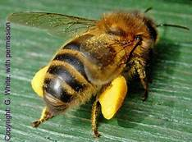
Pollen
Pollen consumption
  1 pound of pollen will develop + 4000 bees
  A strong colony will consume 44 to 70 pounds of pollen annually to produce 200,000 bees a year.

Slide 8
Pollen
Crude protein – estimated protein level in pollen
Healthy pollen % of crude protein (CP%) = 30%+
Minimum Pollen CP% ranges from 20% to 25%

Slide 9
Common Pollen Sources
Buckwheat – 11% CP (crude protein) min (AA) amino acids
Raspberry / blackberry – 20% CP min AA
Blueberry – 14% CP min AA
Pear – 26% CP min AA
Alfalfa – 21% CP min AA
Clover – 25% CP min AA
Corn – 15% CP min AA
Pine – 7% CP min AA
Almond – 26% CP min AA
To provide 10 grams of protein the workers must collection 48 grams of 30% CP or 72 grams of 20% CP protein

Slide 10
Nectar
Nectar is processed into honey.
Sugar content in nectar ranges between 4% to 60% based on floral source
Nectar and sugar concentrations between 30% to 50% maximize collection response.
Sugars in nectar – in order of preference
  Sucrose
  Glucose
  Fructose
Honey nectar is converted by enzymes allowing sucrose to be inverted into glucose and fructose
Honey is 95% to 99% glucose and fructose.

Slide 11
Honey Consumption
Annual honey consumption per hive can be as high as 15
gallons or 150 pounds a year.
1 worker requires 14 mg sugar / day. (Note: 1 teaspoon
contains 4000 mg)
50,000 worker colony requires 1 pound of sugar or 0.5 gal of
1:1 light syrup / day for adult bees.
50,000 worker colony requires 350 pounds of sugar / year.

Slide 12
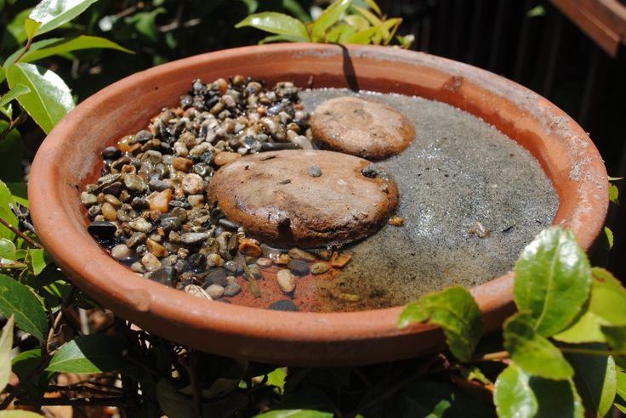
Water
Dilute honey
Maintain humidity within the hive.
Maintain temperature in the brood area
Larval food contains up to 66% water
  Source of minerals
  Bees collect but do not store
  Collect as needed from the nearest sources
  Use 0.5 to 1 gallon per colony every day in the hot summer
  Honey requires 8 gallons of water to make 1 gallon of honey.

Slide 13
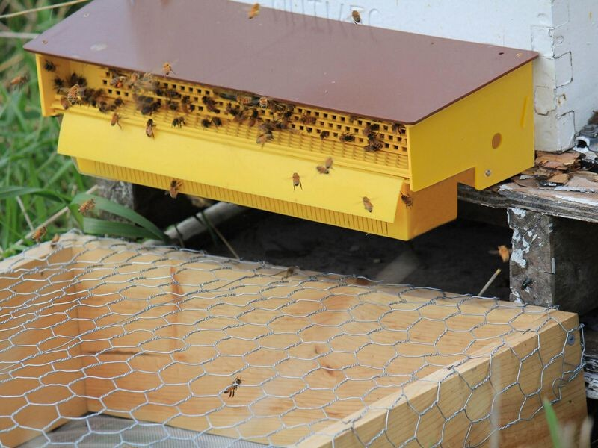
Pollen Feeding – What?
Pollen – protein for bees
  Harvested pollen
  Pollen substitute
    Palatability – bees will consume it
    Digestibility
    Balanced – Amino acids / crude protein
    5% real pollen in substitutes is recommended.
    (Note: Trapping pollen reduces swarming.)

Slide 14
Pollen Feeding – Why?
Lack of pollen varieties – monoculture crops
Weather issues – no flora / restricts access
Stimulates brood production

Slide 15
Sugar Feeding – What?
Sugar – carbohydrates for bees
  White granulated – cane or beet?
  Not brown or powder
High fructose corn syrup
  Largely used in commercial operations
  If it safe / healthy?

Slide 16
Sugar Feeding – Why?
Avoid starvation
Bee package
Establishing a hive – nuc
Lack of forage
Weather issues
Removed to much honey
Need to increase bees – spring and fall
Notes:
Poor feeding practices result in robbing.
Too much / too quickly – swarming
Don’t feed with honey suppers
Essential oils [Honey-B Healthy] enhance bee feeds.

Slide 17
Essential Oils in Beekeeping
Essential Oils
  Over 100 oils that may be used in one form or another
  Common oils used in beekeeping
    Lemongrass
    Spearmint
    Thyme
  Other used:
    Wintergreen
    Eucalyptus
    Peppermint
    Menthol
    Tea tree

Slide 18
Beekeeping Oils
Lemongrass oil –
  Pheromone attractant
  Supplemental food stimulant
  Food preservative
Spearmint oil–
  Used with lemongrass to improve health
Mite Control oil –
  Thymol
  Eucalyptus
  Menthol
  Wintergreen
  Spearmint
  Peppermint
  Tea tree

Slide 19
Sugar Feeding – When?
Spring: March – April – May
  1:2 one sugar to two water. Very light. Stimulates the queen to lay eggs and bees to draw comb
Summer: June – July – August
  1:1 one sugar to one water. Medium. Artificial nectar to feed brood and draw comb.
Fall: September – October – November
  2:1 two sugar to one water. Heavy. Fall or early winter honey substitution to feed your bees.
  (Note: One gallon of heavy syrup (2:1) may increase colony reserves by about 7 pounds.)

Slide 20
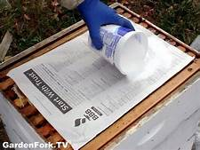
Sugar Feeding – How?
Winter feeding – At temperatures 50° F and below
  Granulated Sugar
  (Note: Granulated sugar does not stimulate brood production)

Slide 21
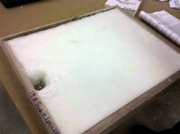
Sugar Feeding – How?
Candy board

Slide 22
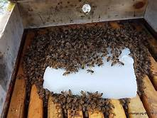
Sugar Feeding – How?
Sugar cakes

Slide 23
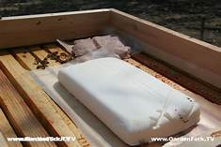
Sugar Feeding – How?
Fondant
(Note: Soft, pliable, dough-like feed.)

Slide 24
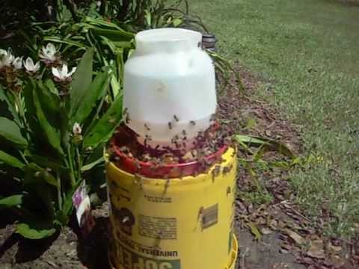
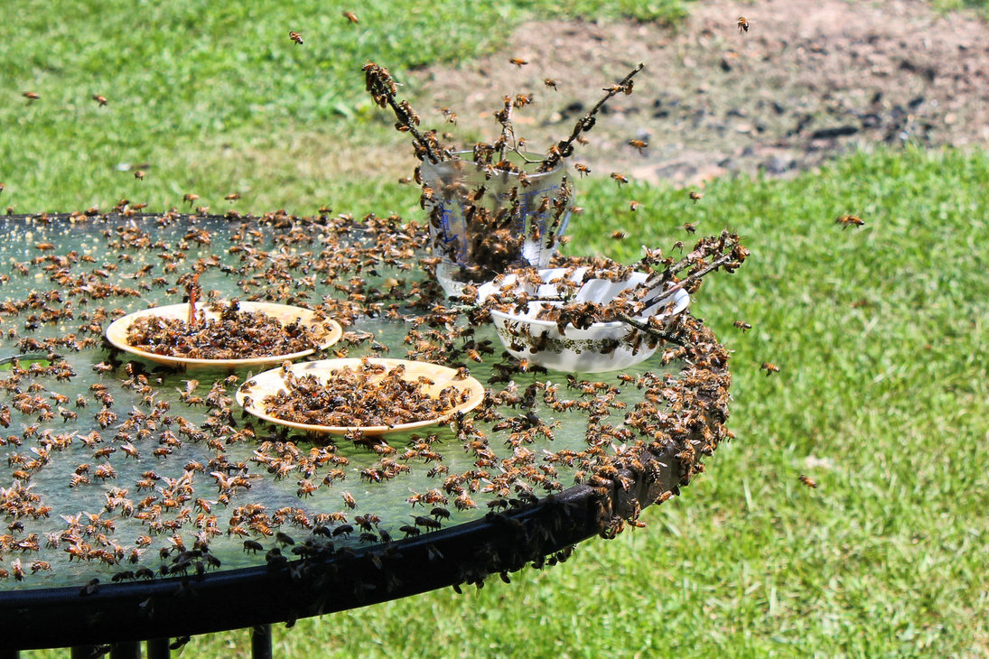
Sugar Feeding – How?
Sugar water feeders
  Open air feeders

Slide 25
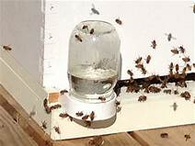
Sugar Feeding – How?
Entrance feeders

Slide 26
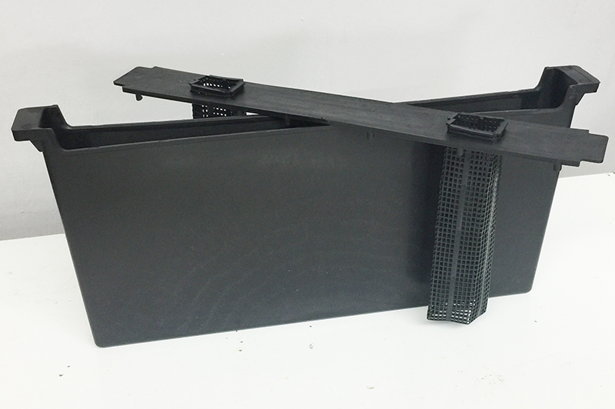
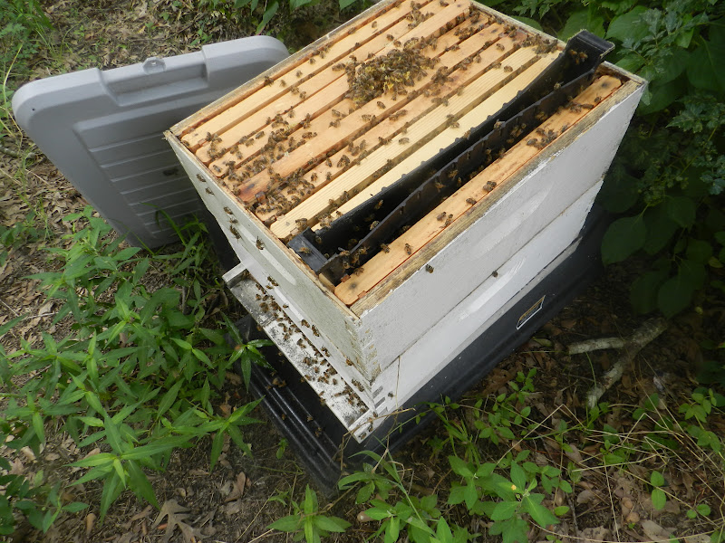
Sugar Feeding – How?
Division board feeder

Slide 27
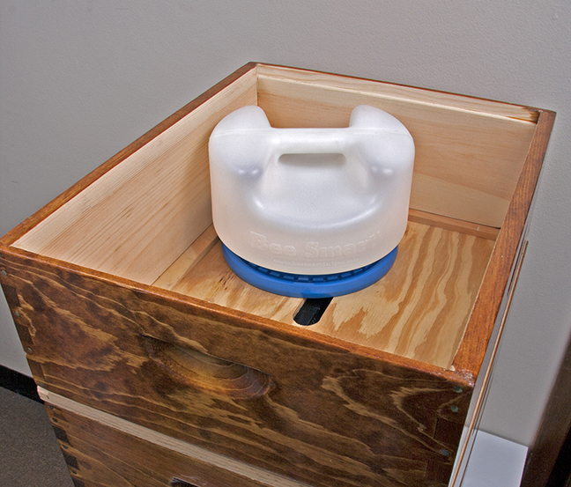
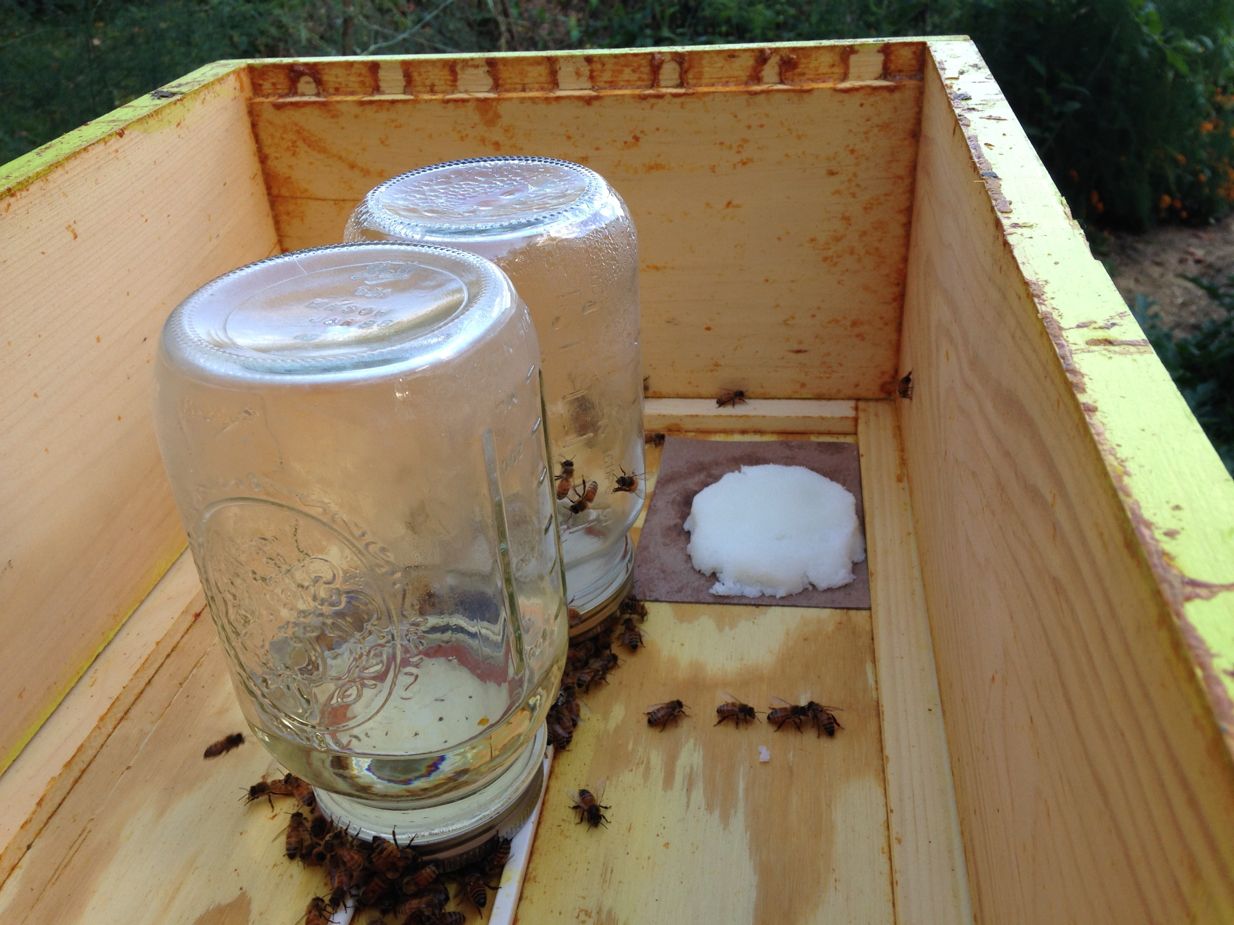
Sugar Feeding – How?
Internal hive top feeders

Slide 28
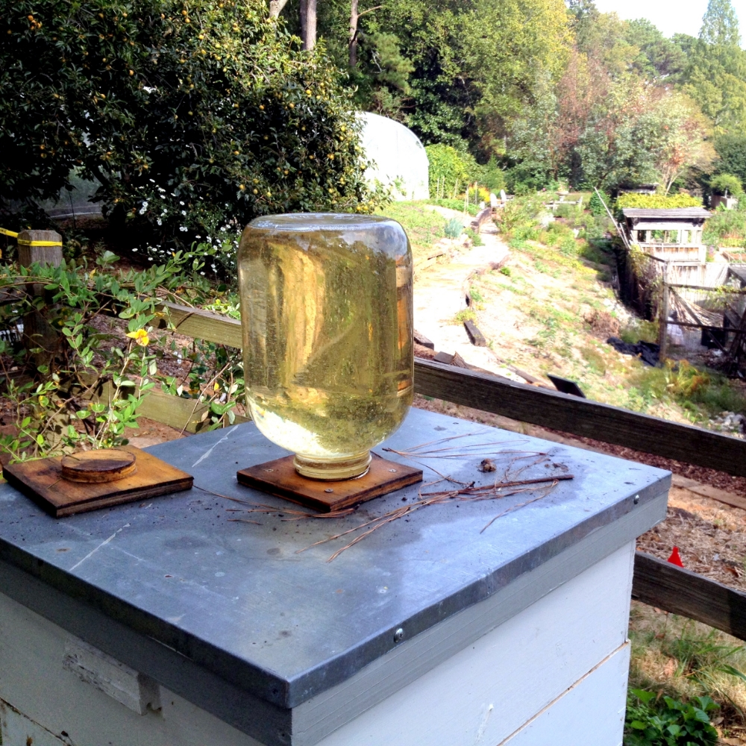
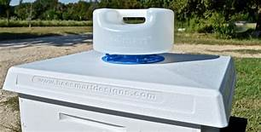
Sugar Feeding – How?
External hive top feeder

Slide 29
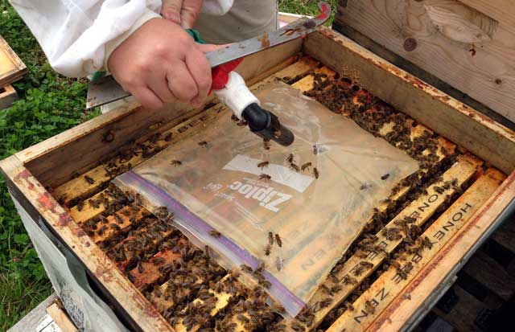
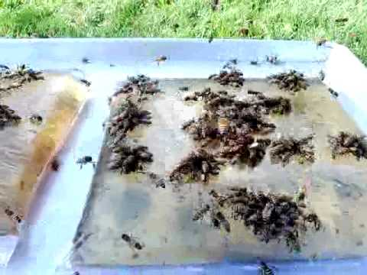
Sugar Feeding – How?
Baggie feeder

Slide 30
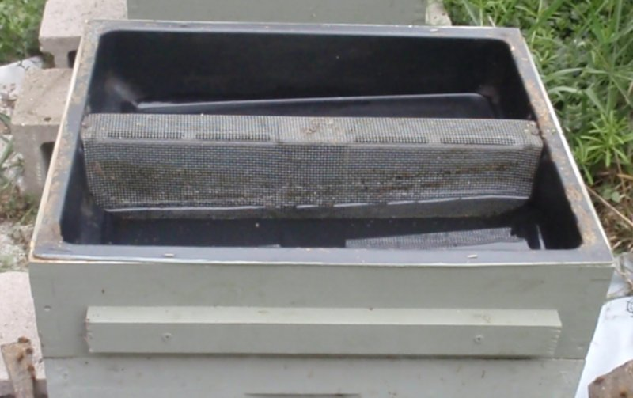
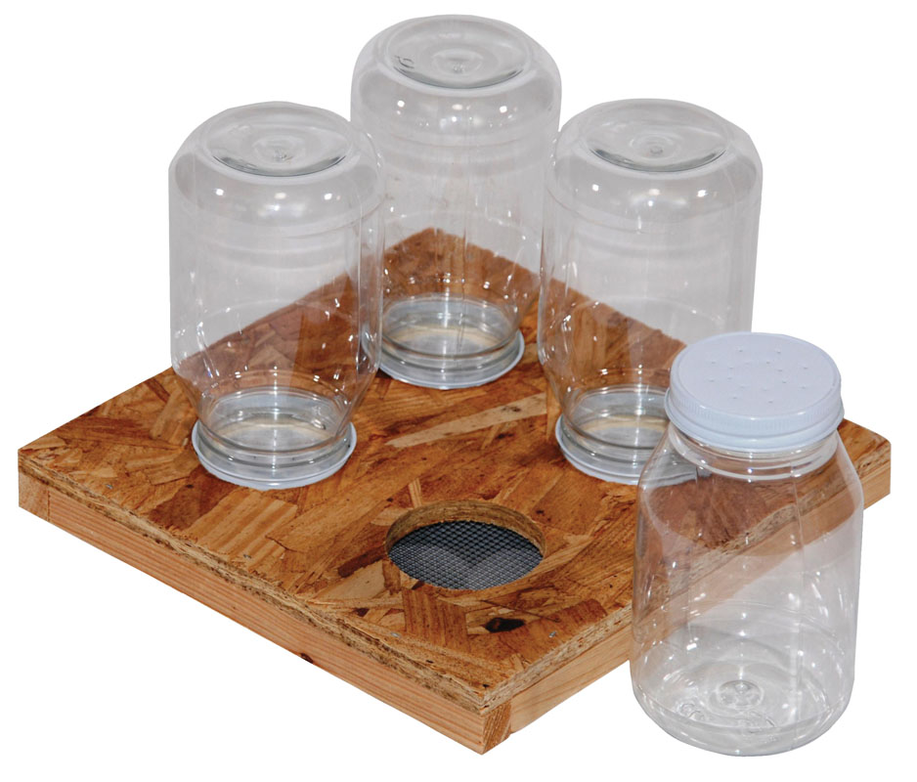
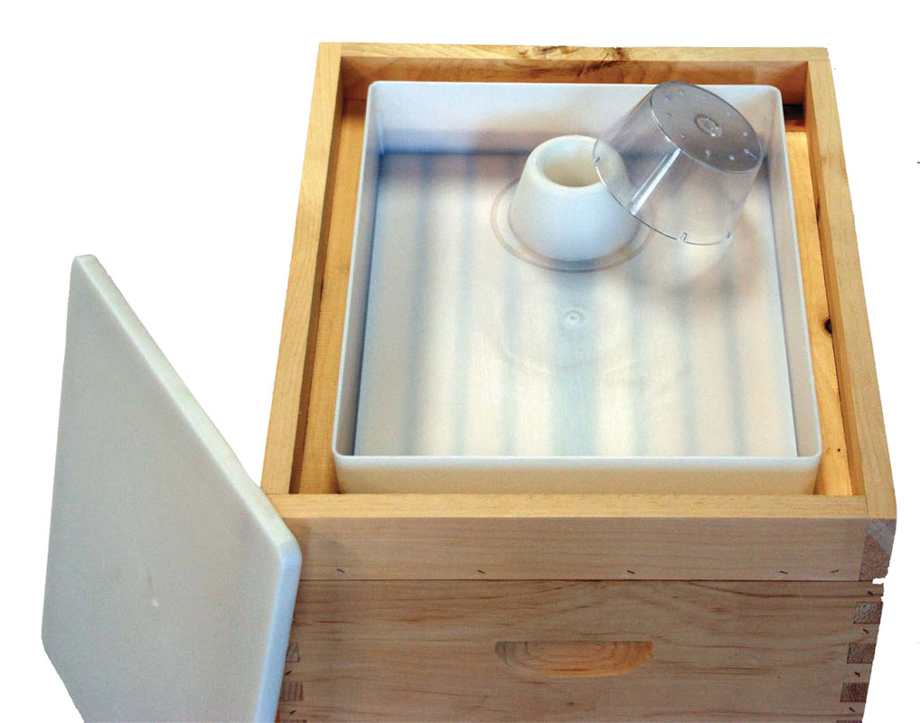
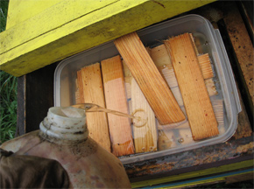
Sugar Feeding – How?
Other feeders

Slide 31
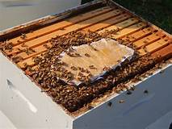
Pollen Feeding – How?
Pollen patties
(Note: A late winter, early spring feed.)

Slide 32
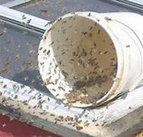
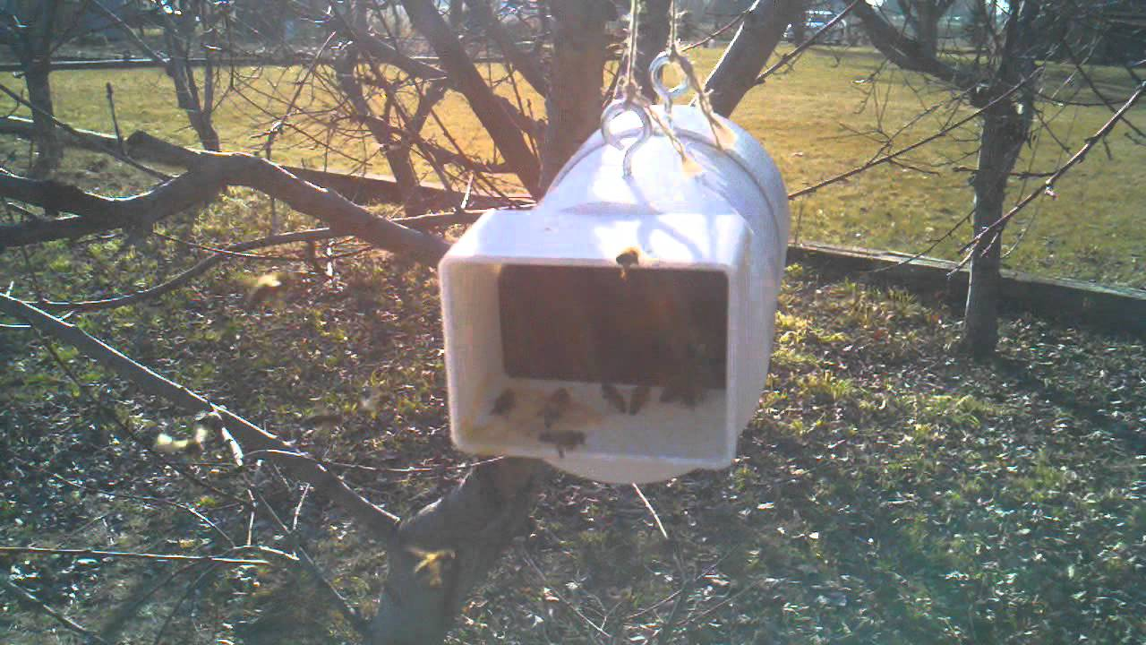
Pollen Feeding – How?
Dry feed pollen
(Note: A late winter, early spring feed.)

Slide 33
Spring Build-up
Start feeding 1:1 syrup mid-February until honey flow begins.
  1:1 stimulates the Queen to start laying. Once you start continue until nectar is available.
  Temperature range should be high 40s to low 50s 3 – 4 days a week.
  If feeding winter food, leave it on until the last of March.
Start feeding protein patties mid-February until the honey flow beings.
  Queen requires protein to lay eggs.
  Feed only what bees will take to avoid hive beetles.
  Continue to feed patties even if the bees bring in March pollen from maples.

Slide 34
Conclusion
Balanced diet supports immune system to battle varroa and associated viruses.
A lot still not understood about bee nutrition.
Benefits of supplemental feeding will vary from location to location.
Timing of protein supplements is important.
Protein supplements. Cost versus benefits.
Protein supplements – spring feeding versus fall feeding in Ohio
Best emergency feed – excess safe honey
Next best emergency feed – moist granulated sugar on wax paper above cluster.
May require spacer rim.

Slide 35
Conclusion
Internal top feeding is the easiest and most efficient way for small beekeepers.
Thin syrup is the basic spring and summer feed. Heavy syrup to supplement
winter food supply.
Heavy syrup fall feeding better than emergency feeding during later winter –
early spring.
Heavy fall feeding better than the use of fondant, sugar blocks or candy board.
Purchasing pre-mixed pollen patties. Quality / cost
Essential oils can be beneficial to honey bees.
Consider organic – Plant a wide variety of trees, shrubs, and plants to provide
nectar and pollen for bees throughout the growing season.

