Slide 1
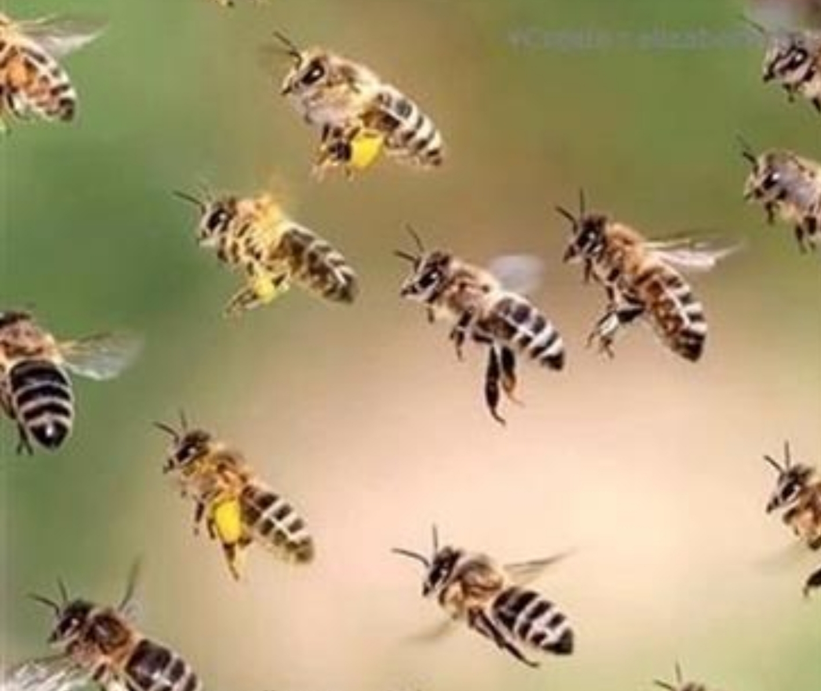
WARREN COUNTY OHIO BEEKEEPERS
VARROA & SMALL HIVE BEETLE
DETECTION &CONTROL

Slide 2
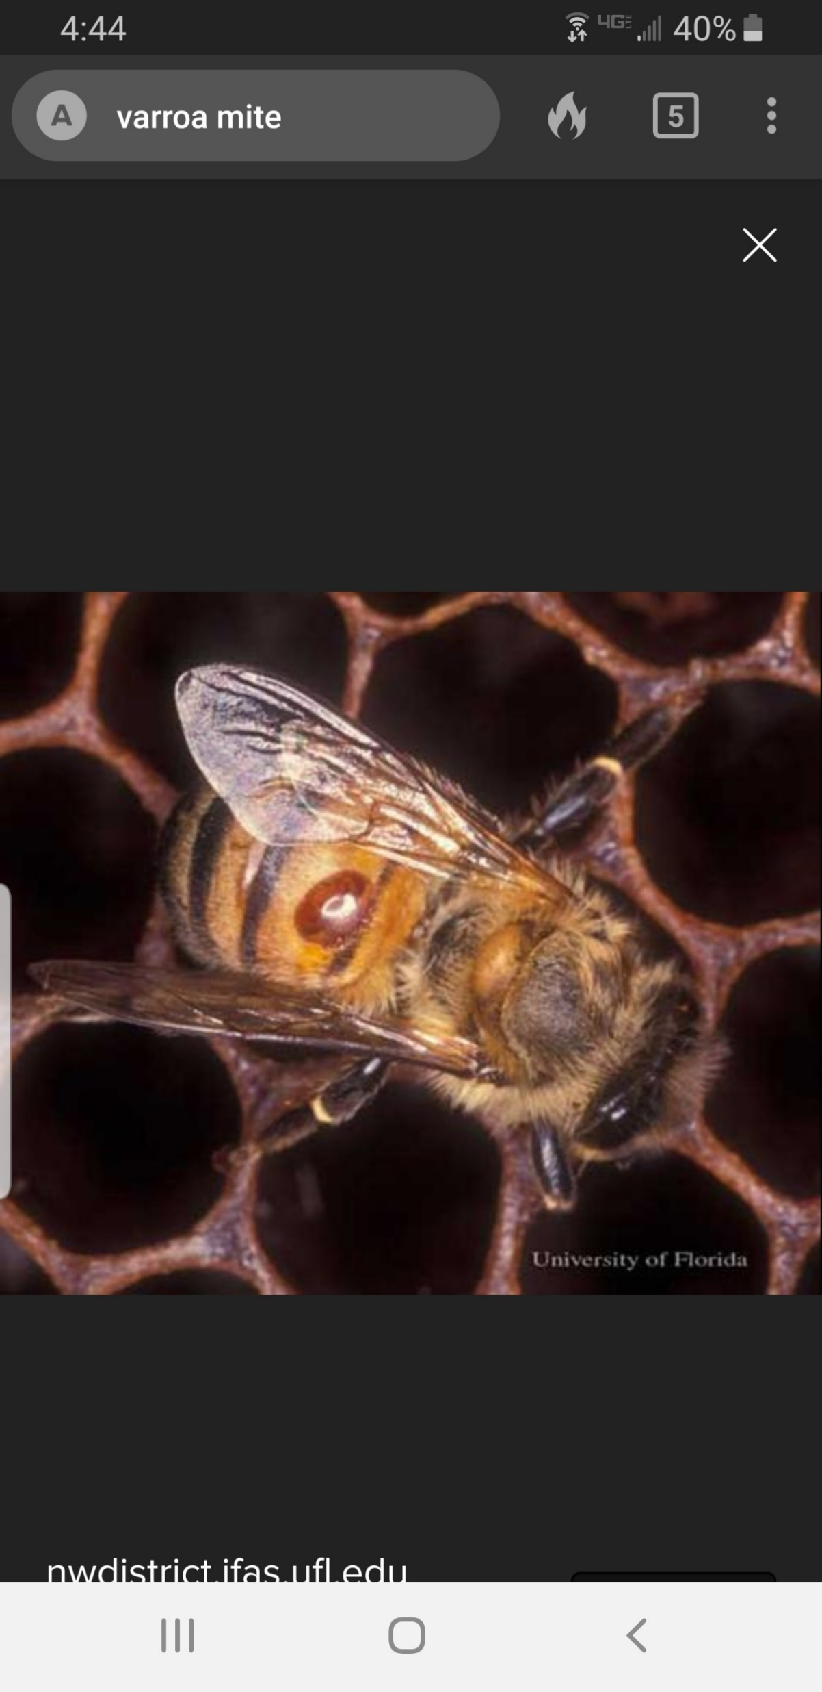
VARROA DESTRUCTOR

Slide 3
VARROA DESTRUCTOR ARE:
    PHORETIC –HITCH RIDES ON WORKER BEES TO GAIN ACCESS TO HIVE
PARASITIC DISEASE VECTORS (THINK TICKS ON HUMANS)
ON EVERY CONTENENT IN THE WORLD EXCEPT ANTARTICA AND AUSTRALIA
ONE REASON FOR COLONY COLLAPSE DISORDER
ARGUABLY THE MOST SERIOUS THREAT TO HONEYBEES
ARE IN EVERY HIVE (INCLUDING YOURS)
IF NOT CONTROLLED, FATAL TO YOUR HIVES – THEN YOUR NEIGHBORS!

Slide 4
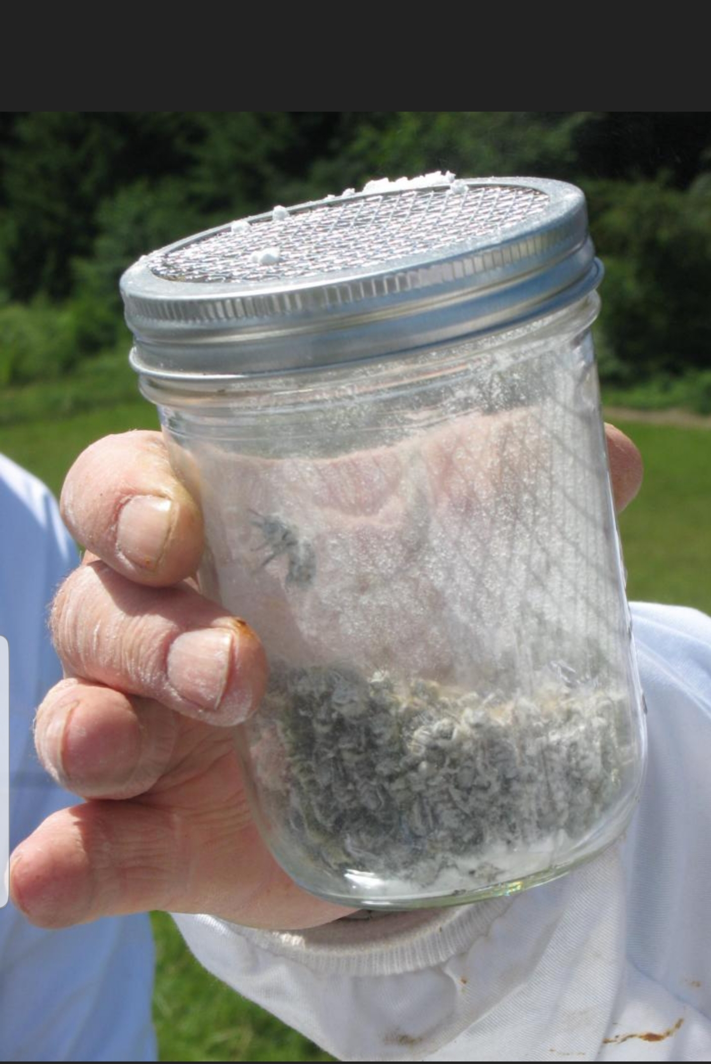
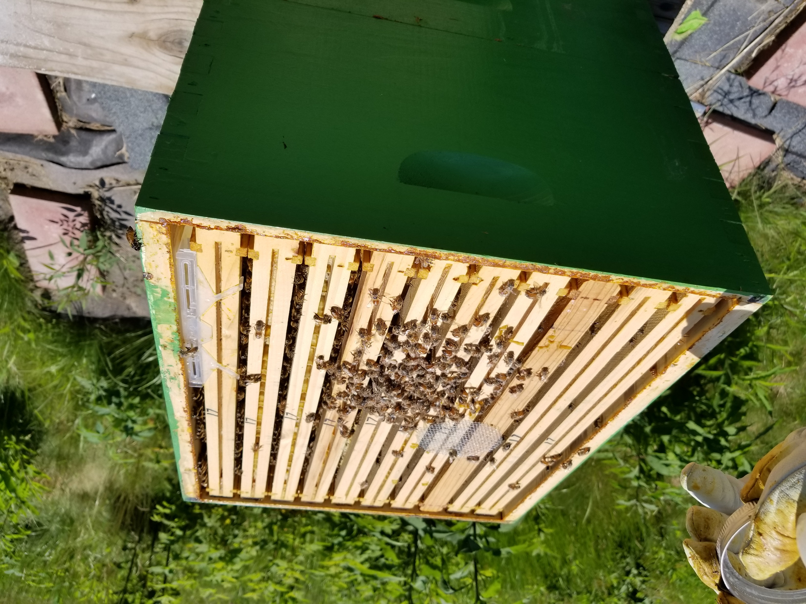
SAMPLING METHODS
ALCOHOL WASH
MOST ACCURATE – KILLS BEES
POWDERED SUGAR ROLL
NOT AS ACCURATE – BUT DOESN’T KILL BEES
STICKY BOARD
LEAST ACCURATE AND LEAST INVASIVE
SAMPLING SHOULD BE DONE ABOUT FOUR TIMES A YEAR

Slide 5
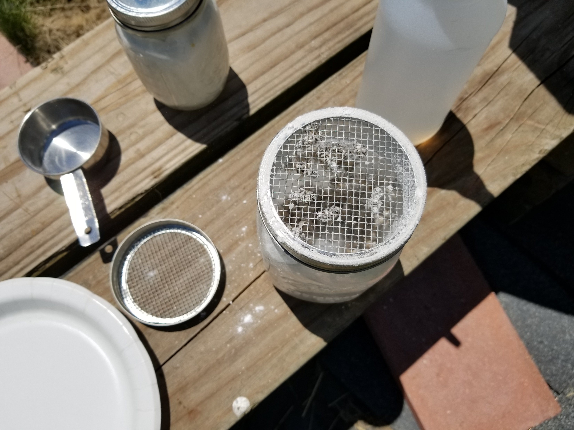
TREATMENT OPTIONS
DOING NOTHING IS NOT AN OPTION!
THERE ARE SEVERAL WAYS TO TREAT FOR VARROA MITES
ANY TREATMENT METHOD WILL HAVE A DOWNSIDE – CHOOSE CAREFULLY
MAY HAVE TO TREAT MORE THAN ONCE.
INTEGRATED PEST MANAGEMENT (IPM)

Slide 6

TREATMENT RESOURCES
HONEYBEE HEALTH COALITION
TOOLS FOR VARROA MANAGEMENT
EXPLAINS THE DIFFERENT SAMPLING METHODS
VARROA MANAGEMENT DECISION TOOL
EXPLAINS TREATMENT OPTIONS AND SIDE EFFECTS
Honeybeehealthcoalition.org

Slide 7
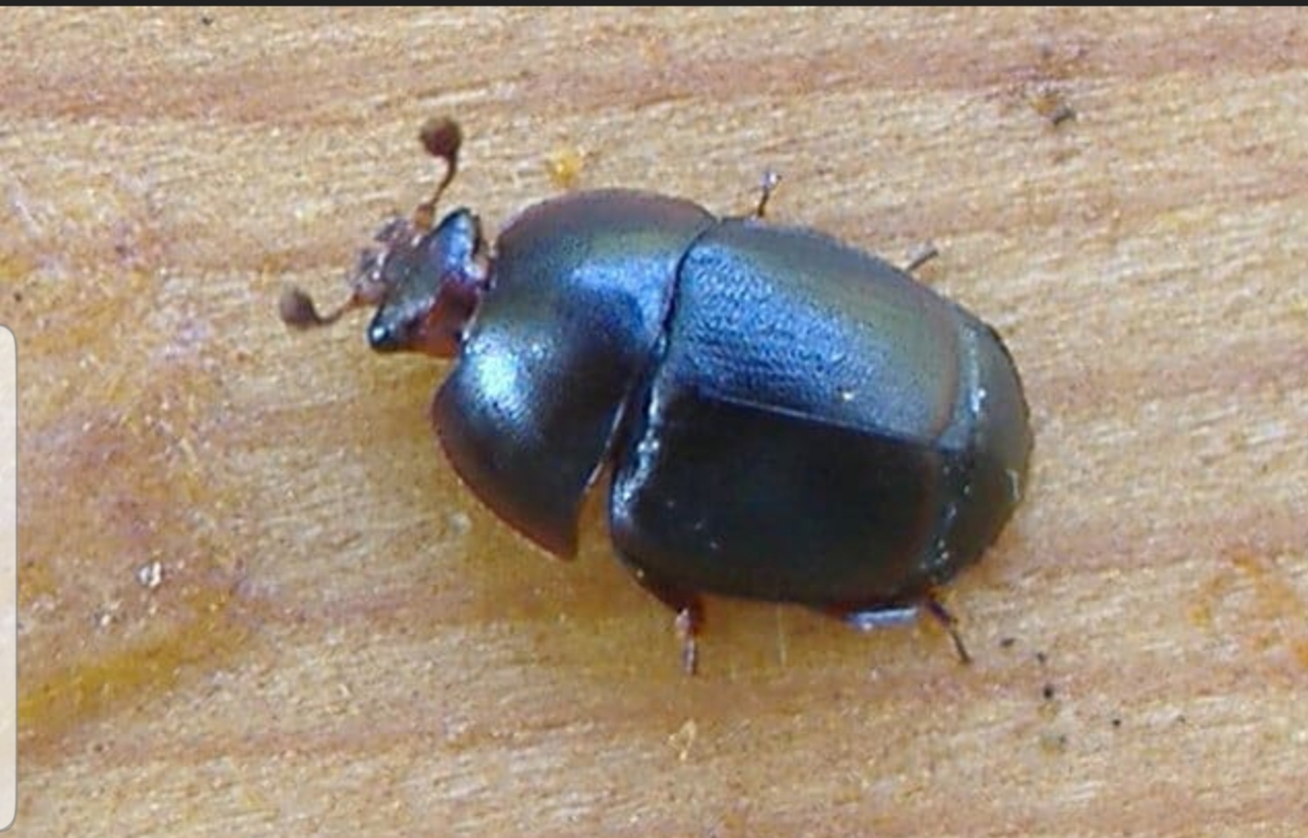
SMALL HIVE BEETLES
IF VARROA ARE LIKE TICKS HIVE BEETLES ARE LIKE ROACHES

Slide 8
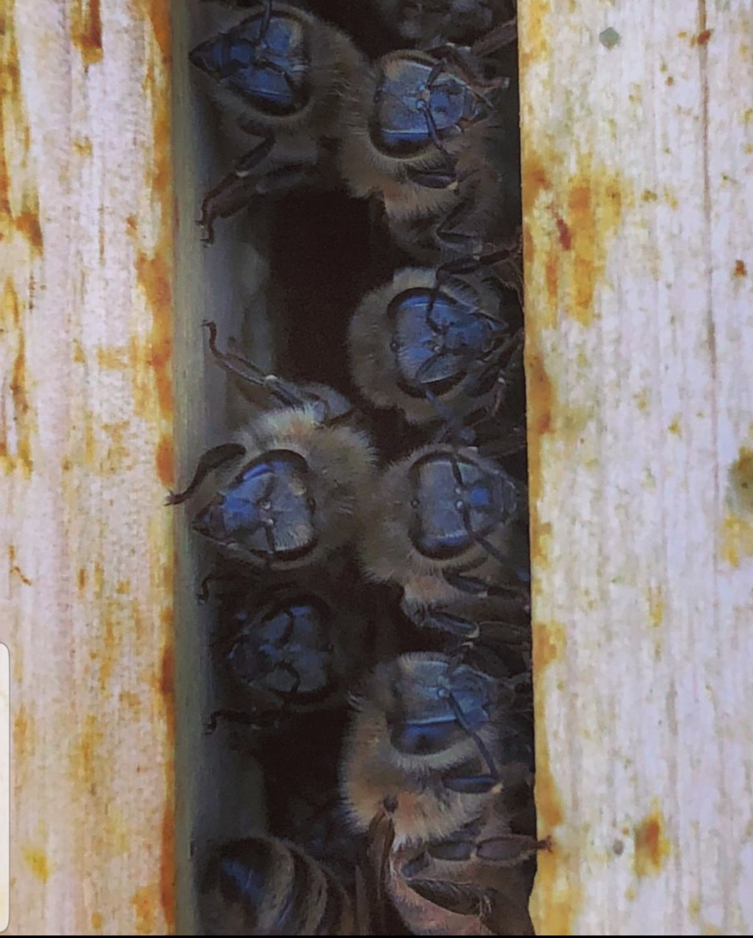
NOT AS SERIOUS A PROBLEM IN A STRONG COLONY
WILL HASTEN COLONY COLLAPSE IN WEAK COLONIES,
SUCH AS NEW PACKAGES AND NUCS, IF LEFT UNCHECKED
EASIER TO DETECT THAN VARROA

Slide 9
TREATMENT OPTIONS FOR SHB
BEES WILL CHASE SHB TO UPPER CORNERS OF HIVE BOX
SWIFFER SHEETS
ALSO WILL TRAP BEES
COMMERCIALLY PURCHASED BEETLE TRAPS
DISPOSABLE/REUSABLE
MESSY - KILLING AGENT USUALLY MINERAL OR VEGETABLE OIL
I HAVE BEEN USING PICKLING LIME AS KILLING AGENT – LESS MESSY.
AN INFESTATTION OF SHB CAN CAUSE BEES TO ABSCOND
(YOU WOULDN’T LIVE WITH A ROACH INFESTATION WOULD YOU?)

Slide 10
RESOURCES
WARREN COUNTY OHIO BEEKEEPERS
Warrencountybeekeepers.org
OHIO STATE BEEKEEPERS ASSOCIATION
Ohiostatebeekeepers.org
HONEYBEE HEALTH COALITION
Honeybeehealthcoalition.org
UNIVSERSITY OF GUELPH HONEYBEE RESEARCH CENTER
Uoguelph.ca/honeybee/videos

Slide 11
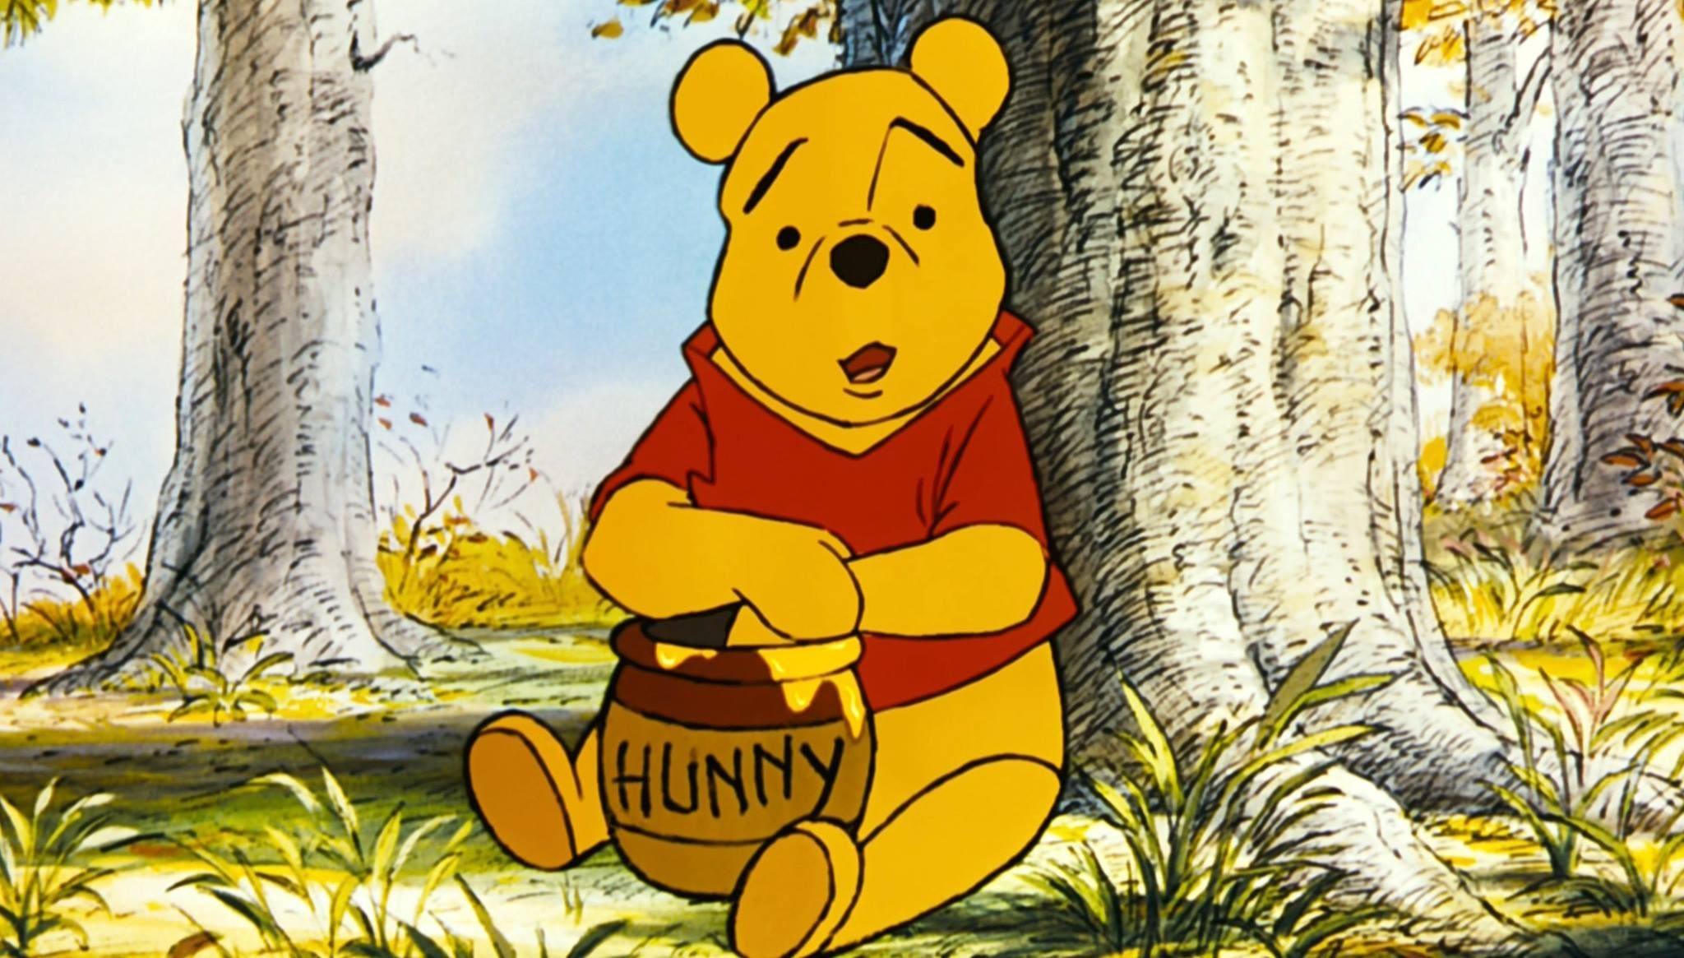
IMPORTANT TAKE AWAYS
“YOU CAN NEVER TELL WITH BEES”
WINNIE THE POOH – 1924
“THERE ARE ABSOLUTLEY NO ABSOLUTES WITH HONEYBEES”
GEOFF HULTGREN -2017 (THE YEAR I GOT MY FIRST COLONY)

