Slide 1
Seasonal Management of Beekeeping
Gary Keuffer
Brown County Beekeepers Association

Slide 2
Overview
Each season is different for the bees; nature presents unique seasonal challenges for bees
Accordingly, the beekeeper should be prepared to perform certain management actions to help their honey bees thrive
We will examine some of the top-level tasks and actions that correspond with the seasons
  Winter
  Spring
  Summer
  Fall

Slide 3
Beekeeping Rules
There are no rules -- only generalities
  Bees will make exceptions to any and every rule!
Don't expect any two seasons to be the same
There is no “single, right way" to manage bees
  Depends upon your location, timing, goals, weather, phenology, etc.
All beekeepers make mistakes
Beekeeping will always consist of a series of surprises
Notes:
Phenology: the study of cyclic and seasonal natural phenomena, especially in relation to climate and plant and animal life

Slide 4
Good Management Practices
Sound management practices include:
  Increasing or reducing colony space as needed
  Preventing swarming of bees
  Providing food supplements when needed:
    To offset shortcomings in winter stores
    To help stimulate brood production
    During dearth conditions
  Keeping young and productive queens in colonies
  Managing diseases, pests, and parasites
Timing is everything

Slide 5
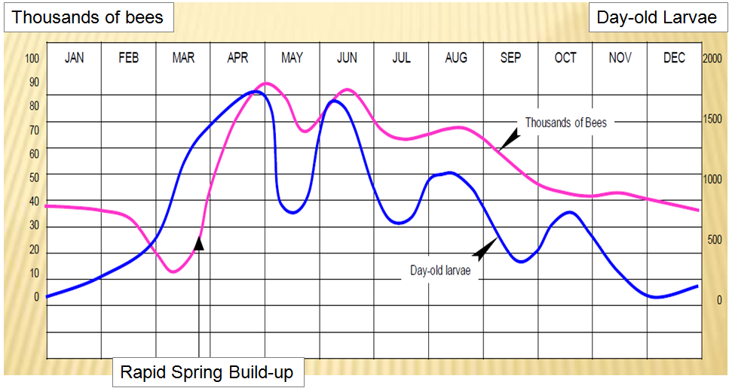
Colony Population Life-Cycle

Slide 6
Winter Management (Dec – Feb)
Bee Activity:
Dec: Nearly no activity, no brood rearing, low food consumption
Jan: Winter cluster mostly
  Main dangers are moisture in hive and low temperatures keeping bees from moving to food sources (starvation)
Feb: Winter cluster slowly breaks as temps rise
  Queen begins to lay for early spring
  Foragers begin to collect pollen
Winter bees beginning to reach the end of their life span

Slide 7
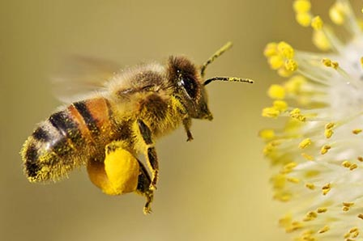
Winter Management (Dec – Feb)
Vegetative Growth:
Dec: Plants are dormant.
Jan: Plants are dormant, preparing for spring
Feb: Elms, maples, and willows begin to bloom
  These are prime pollen sources that will help kick-start egg-laying and brood rearing

Slide 8
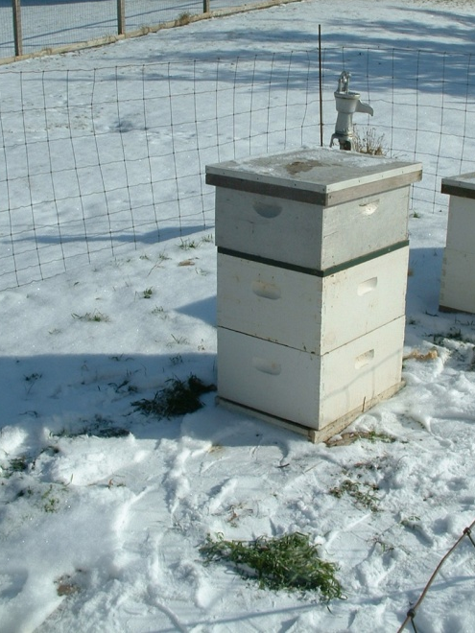
Winter Management (Dec – Feb)
Beekeeper activity:
Dec:
  Plan for next year
  Clean equipment/buy new equipment
  Read, study, learn
Jan:
  Check hives periodically
  Keep entrances clear
  Tap on hive to locate cluster within the hive
  Order packages and queens
Feb:
  Early inspection on warm days
  Light colonies can be fed sugar syrup, candy/fondant or dry sugar
  Add pollen supplement if early brood rearing is desired

Slide 9
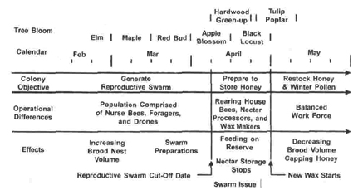
Spring Transition Within Colony

Slide 10
Spring Management (Mar – May)
Bee activity:
Mar:
  Queen laying picks up drastically in prep for honey flows
  Winter bee population is dying off
  Food stores and temperature regulation become critical issues
April:
  Main goal is brood rearing. Queen laying at peak level (1,000 - 2,000 eggs/day).
  Food stores become THE critical issue
  1cell pollen+1cell honey+1cell water = 1 bee
May:
  Brood rearing drops. Swarming impulse begins as hive becomes crowded

Slide 11
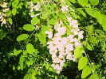
Spring Management (Mar – May)
Vegetative Growth:
Mar:
  Willows/Maples/Elms in full flower
  Early spring flowers begin bloom
  Lots of pollen some nectar
April:
  Apple, pear, plum, cherry, crabapple, spring flowers, dandelions
  Lots of pollen and nectar; almost all converted into brood
May:
  Fruit bloom continues
  Black Locust begins blooming (big honey flow)
  Clovers begin toward end of month

Slide 12
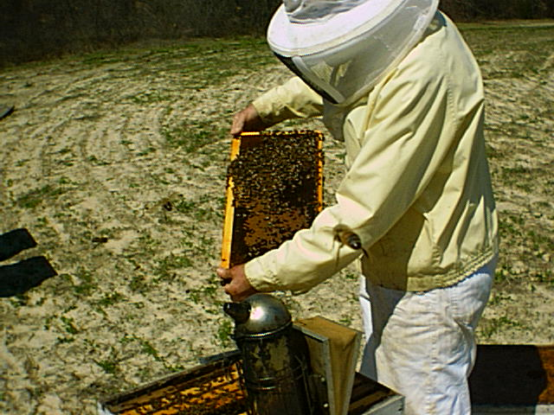
Spring Management (Mar – May)
Beekeeper activity:
Mar:
  First full hive inspections (temps above 55)
  Check food stores and feed if needed (many colonies starve in March)
  Treat for Varroa Mites (if necessary)
April:
  Install packages and/or new queens
  Begin to manage for swarms
  Reverse hive bodies
  Make Nucs or Splits
May:
  Continue swarm control
  Install honey supers

Slide 13
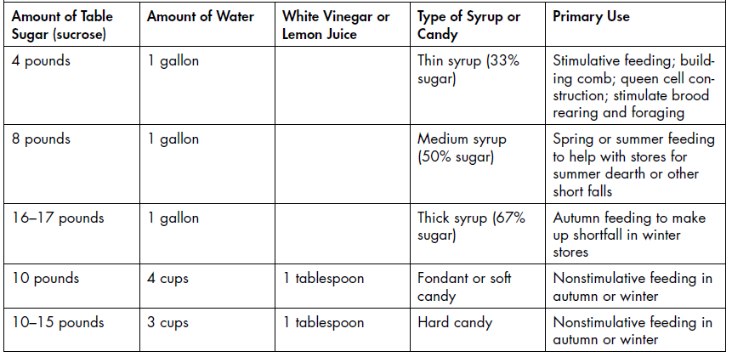
Ratios for Sugar Feeding

Slide 14
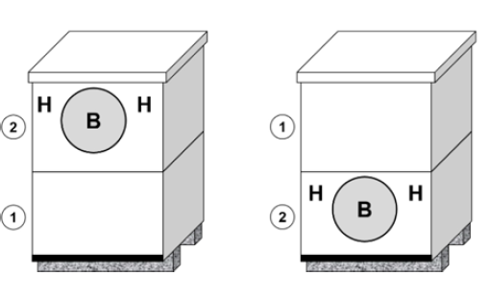
Reversing Hive Bodies
By the end of winter, the colony will have moved into the upper-most hive body
Late Winter
Early Spring
The goal is to reverse the hive boxes so the brood (B) and remaining honey (H) are positioned at the bottom of the overall hive
This will allow additional upward movement for the colony as it expands throughout the spring

Slide 15
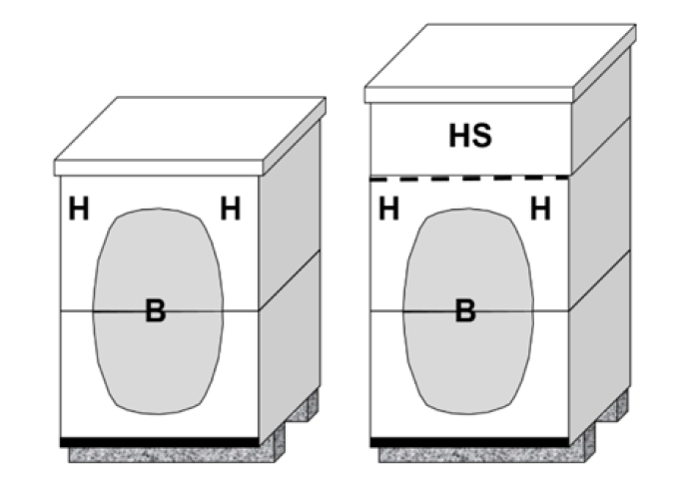
Adding Honey Supers
In the Langstroth hive, bees will store honey above the brood chambers
Beekeepers will generally place multiple honey supers (HS) above the brood chamber
Without Super
With Super
This will allow additional nectar collection/honey processing by the bees

Slide 16
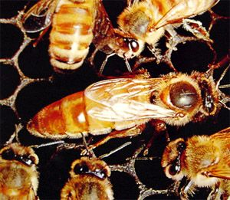
Summer Management (Jun – Aug)
Bee activity:
Jun:
  Bee populations peak and begin to decline
  Swarming season still active but begins to decline
  Nectar collection and processing
July:
  Queen slows egg laying
  Cooling the hive processing of nectar
  Wax production
Aug:
  Drone production begins to drop
  Nectar processing complete

Slide 17
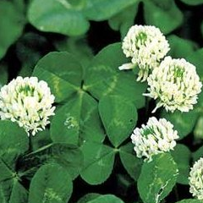
Summer Management (Jun – Aug)
Vegetative Growth:
Jun:
  Basswood (Linden) bloom and secrete nectar
  Yellow and white clovers peak
  Other clovers begin to bloom
July:
  White sweet clover
  Milkweed and buckwheat
  Nectar production declines/ dearth begins
Aug: Goldenrod, aster, milkweed, and alfalfa

Slide 18

Summer Management (Jun – Aug)
Beekeeper activity:
Jun:
  Additional supering to keep room for the colony to store nectar and provide enough space to discourage swarming
  Stay ahead of colony with empty supers
July:
  First harvests and honey extraction
  Monitor colonies for robbing activity
  Ensure the colony has access to plenty of water
Aug:
  Harvest and extract honey
  Begin Varroa Mite treatments

Slide 19
Fall Management (Sep – Nov)
Bee activity:
Bees “desperate” to fill hive/food chamber with winter stores
Can be “Hot” (mean tempered) as a result
Will work as long as plants secrete nectar
Queen begins to produce Winter Bees
Drone production drops to minimal / drones cast out by workers

Slide 20
Fall Management (Sep – Nov)
Vegetative Growth:
Sep:
  Goldenrod and Aster peak then sharply
  Many other nectar sources are dwindling
Oct:
  Only minimal nectar production at best
Nov:
  No nectar/ no pollen

Slide 21
Fall Management (Sep – Nov)
Beekeeper activity:
Sep:
  Feed colonies now so syrup can be processed and stored properly
  Finalize Varroa Mite treatments
Oct:
  Install mouse guards/entrance reducers
  Check food stores
Nov:
  Check food stores

Slide 22
Summary
Seasonal Management can be crucial to maintaining your colonies' health and welfare
  Timing is critical
  Understand the bee’s life-cycle; both at the colony and individual level
  Understand the environment and micro-environments of your area

Slide 23
Credits / More Info
Photos/drawings/charts sourced from the internet and private collections all copyright controlled.
More information is available from
  The Ohio State Beekeepers Association (www.ohiostatebeekeepers.org)
  Scientific Beekeeping (http://scientificbeekeeping.com)
  Purdue University Bee Lab (https://extension.entm.purdue.edu/beehive/)

